Slide 1

Load Balancing in cloud computing – A hierarchical taxonomical classification By Shahbaz Afzal and G. Kavitha
Flavian Daniel Rotaru

Slide 2


Introduction
The article opens up with the definition of Cloud Computing and what it represents for the “Giant Players”, as the paper describes them.
Here, the authors explain the problem of Loud Balancing and point out the four main contributions that they bring to solving it:
It tries to explore the main causes for the problem of load unbalancing in cloud computing
It outlines an analysis over the already existing approaches in the process of load balancing and the way they have been used in Cloud Computing.
It provides a thorough classification of the different techniques, methods strategies and algorithms, all used in load balancing.
The article offers an analysis over the different challenges that have been faced by researchers while trying to develop efficient algorithms.

Slide 3
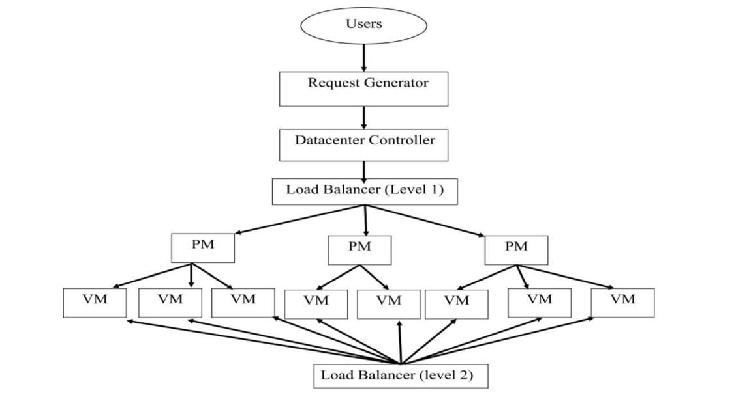
Load balancing model background
Gives a brief overview over a two-level architectural load balancing model and how it is used in imbalanced clouds for solving the problem of load shedding.
The main activities involved in load balancing are also presented in this chapter:
User task requirements identification
VM resource details identification
Task Scheduling
Allocation of resources
Migration

Slide 4
Activities involved in load balancing
Outlines other related work that has been done in the field of cloud computing
Credits other authors and papers for their work in the field of load balancing and cloud computing alike
Such examples:
Ghomi proposed a survey on load balancing algorithm in cloud computing.
Milani reviewed existing load balancing techniques, established on the survey
Kalra and Singh conducted a comparative study of various scheduling algorithms for cloud and grid computing considering five fundamental meta-heuristic methods
Mesbahi and Rahmani classified load balancing algorithms into three categories: general algorithm based, architectural based and artificial intelligence based

Slide 5
Research methodology
Outlines the way authors tackled the research done for the writing the paper
Presents the for main questions that this article tries to explain:
“What causes the load unbalancing problem?”
“Why load balancing is the need of hour in cloud computing?”
“Does load balancing consider the evaluation of single objective or multi-objective functions?”
“What is time complexity of load balancing algorithm?”

Slide 6
Proposed classification of load balancing algorithms
There is also a need for a classification that best gives the perspective over where algorithms stand in taxonomy.
Focus point of the fifth section is to present the various criteria used for the classifications.
Nature of the algorithm
State of the algorithm
Trait used for load balancing
Functionality
Type of load balancing
Technique used for load balancing

Slide 7
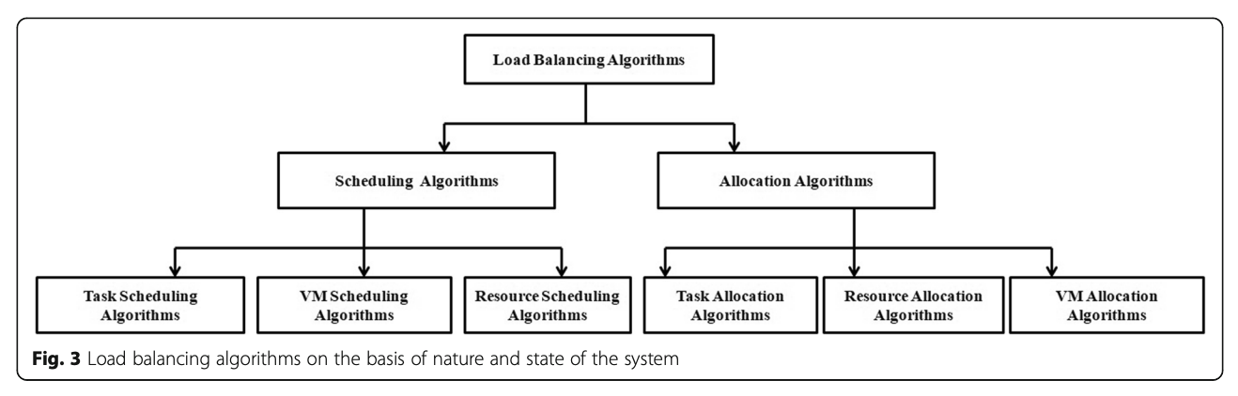
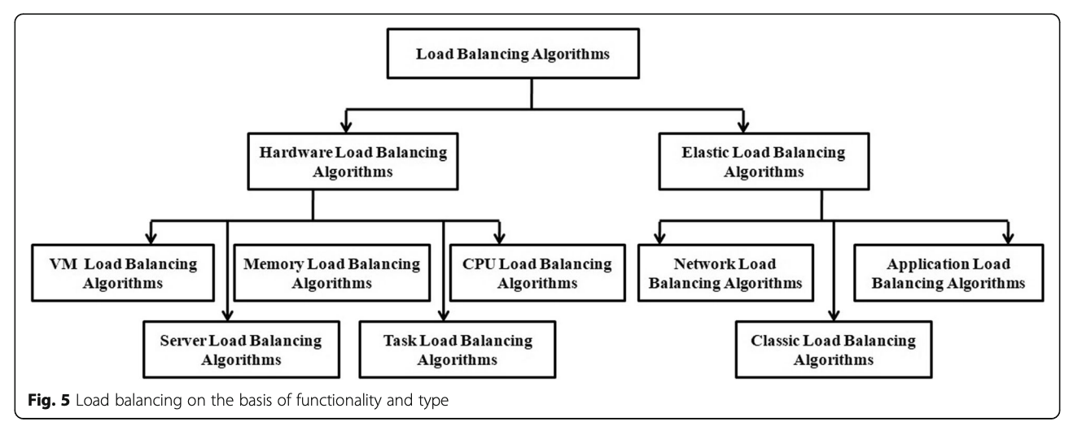

Slide 8
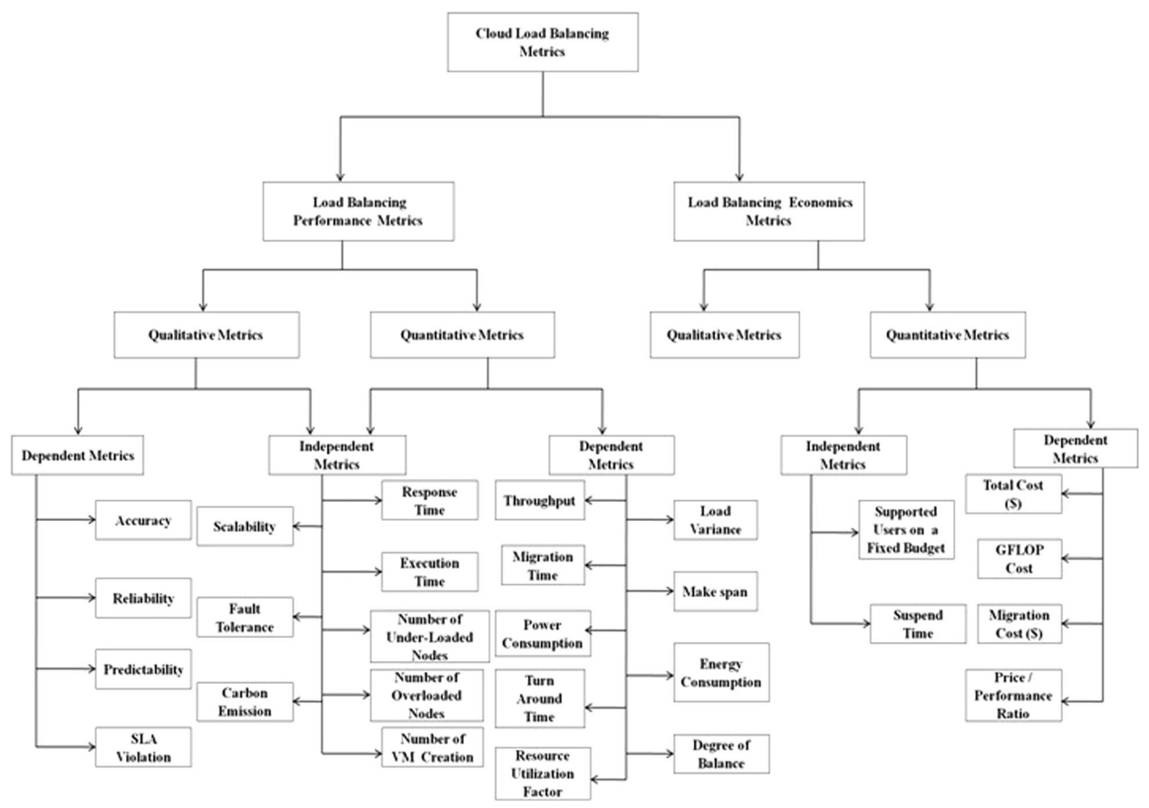

Slide 9
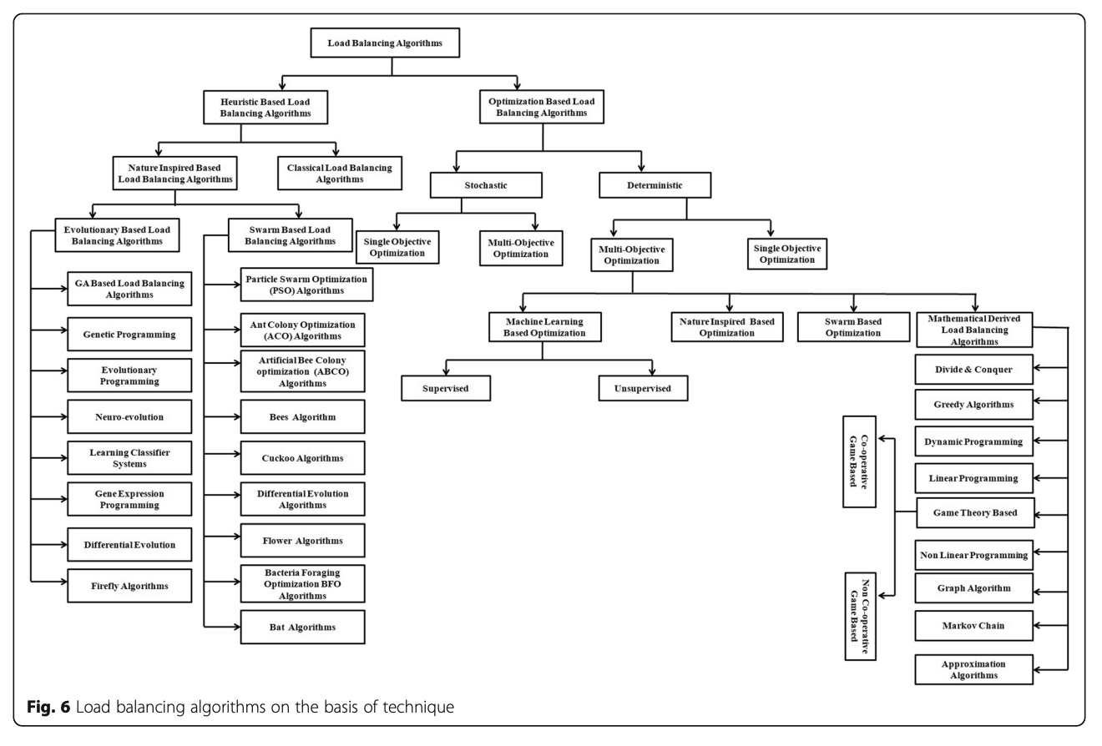

Slide 10
Conclusions and final thoughts
The most important conclusion reached by the authors of the article:100% of proactive approaches are dynamic, but not all dynamic approaches need to be proactive (i.e., they can represent reactive approaches as well).
Second conclusion: 80% of the examples chosen by the authors does not consider the complexity of the algorithm as a major turning point in that performance.
By applying efficient and sophisticated algorithms along the metrics of the quality of the services, and correctly evaluating algorithms in each situation, the gaps that currently exist in the load balancing process can be significantly reduced, guiding future researchers, at the same time, to deal with the already lasting problems in Cloud Computing industry.

Slide 11
Thank you! Flavian Daniel Rotaru flavian.rotaru@s.unibuc.ro
flavian.daniel.rotaru@gmail.com

